Slide 1
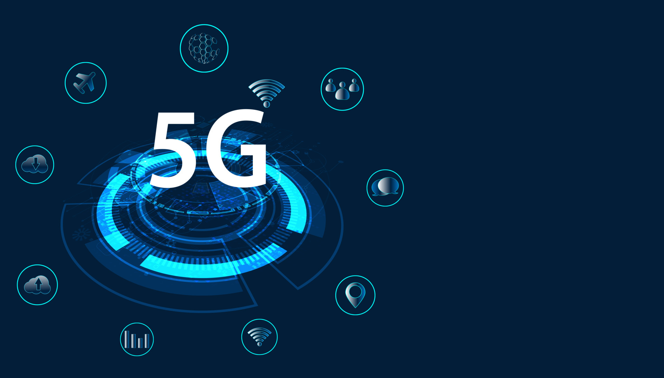
5G TECHNOLOGY
GUIDED BY
MOHAMMAD TAHIR MIRJI
L2 KTC Hubli
BY:
Supriya M Kshirasagar

Slide 2
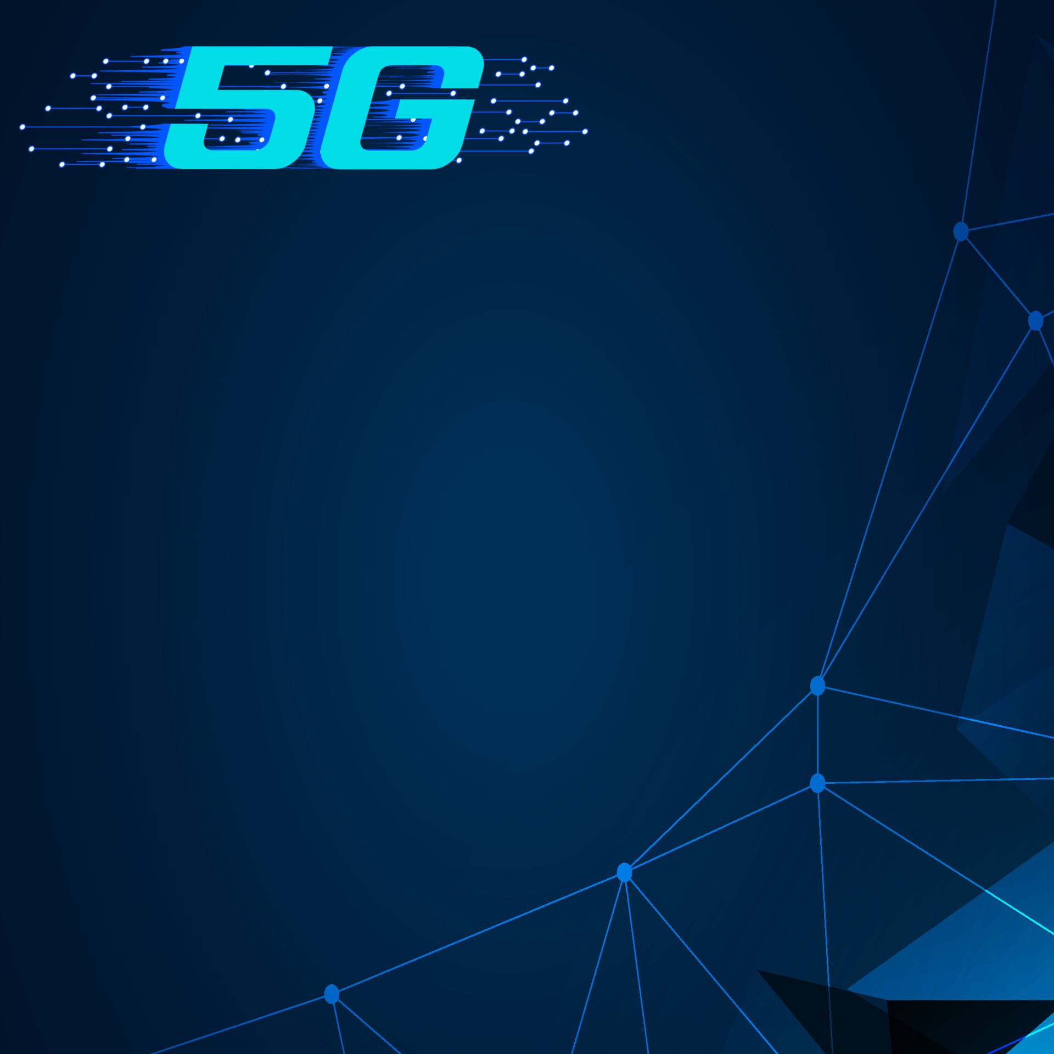
What Is 5G?
5G technology refers to the fifth generation of wireless communication technology.
It is an advanced network infrastructure that provides faster data speeds, lower latency (delay), and increased capacity compared to previous generations like 4G (LTE) technology.

Slide 3

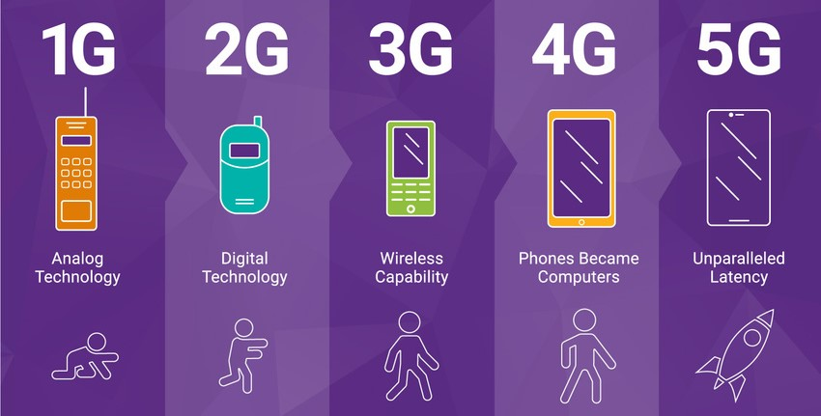
Mobile Technology Generations

Slide 4

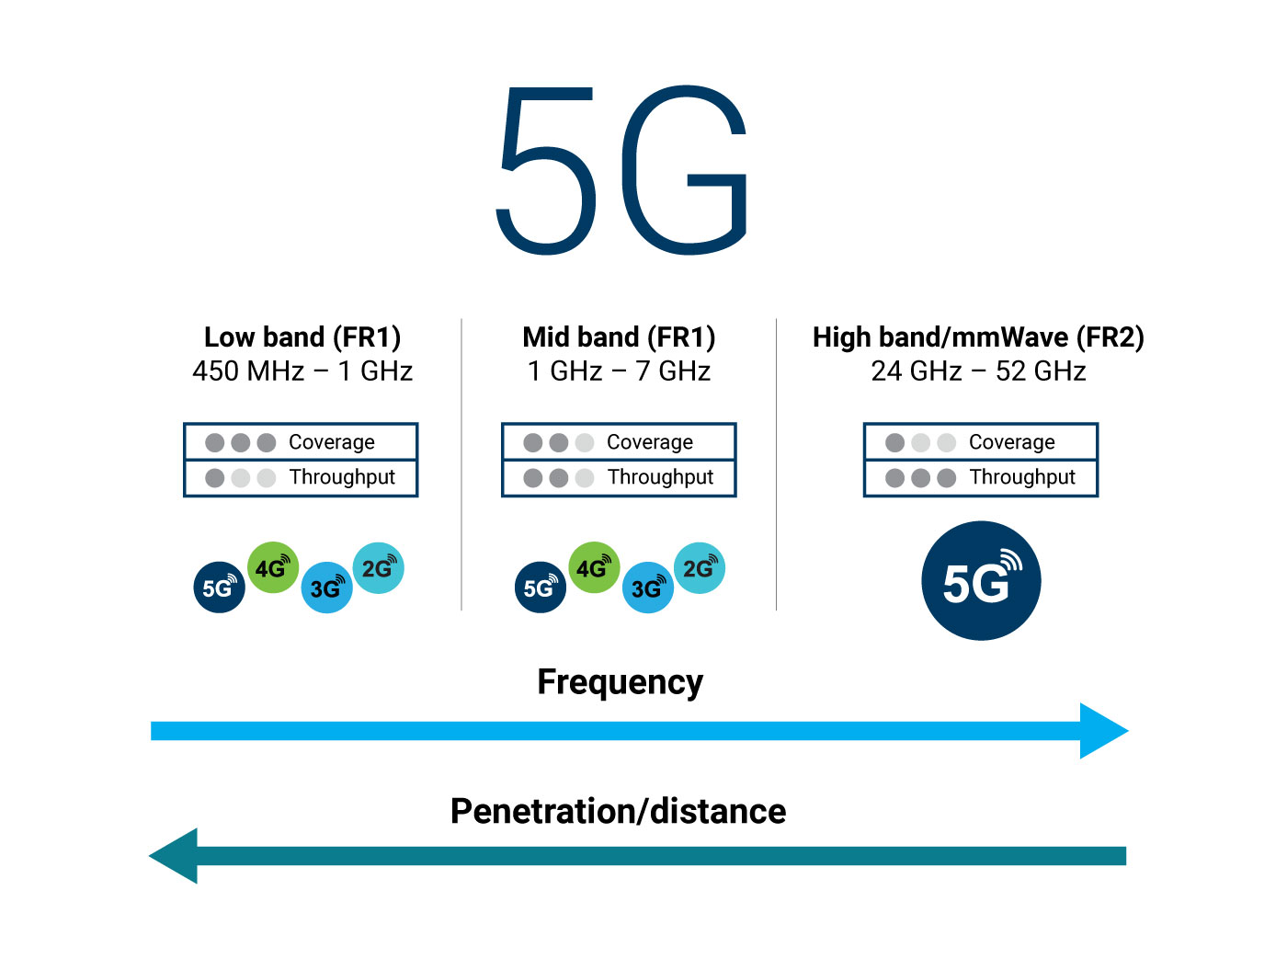
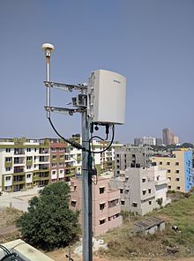
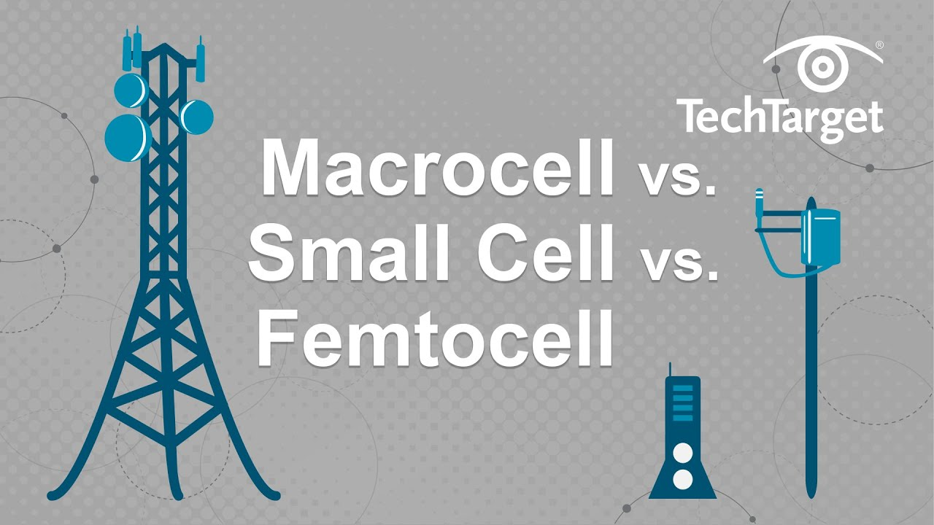
How 5G WORKS…?
Frequencies and Spectrum: 5G utilizes a wider range of frequencies, including higher frequency bands known as millimeter waves. These higher frequencies enable faster data transmission but have shorter range and can be easily obstructed by obstacles like buildings and trees.
Small Cells: To overcome the shorter range of higher frequencies, 5G networks deploy smaller cell stations called "small cells." These small cells are distributed more densely, covering smaller geographic areas compared to traditional cell towers. By having more small cells, the network can provide better coverage and capacity in specific locations.

Slide 5
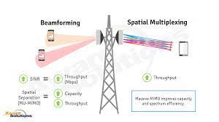
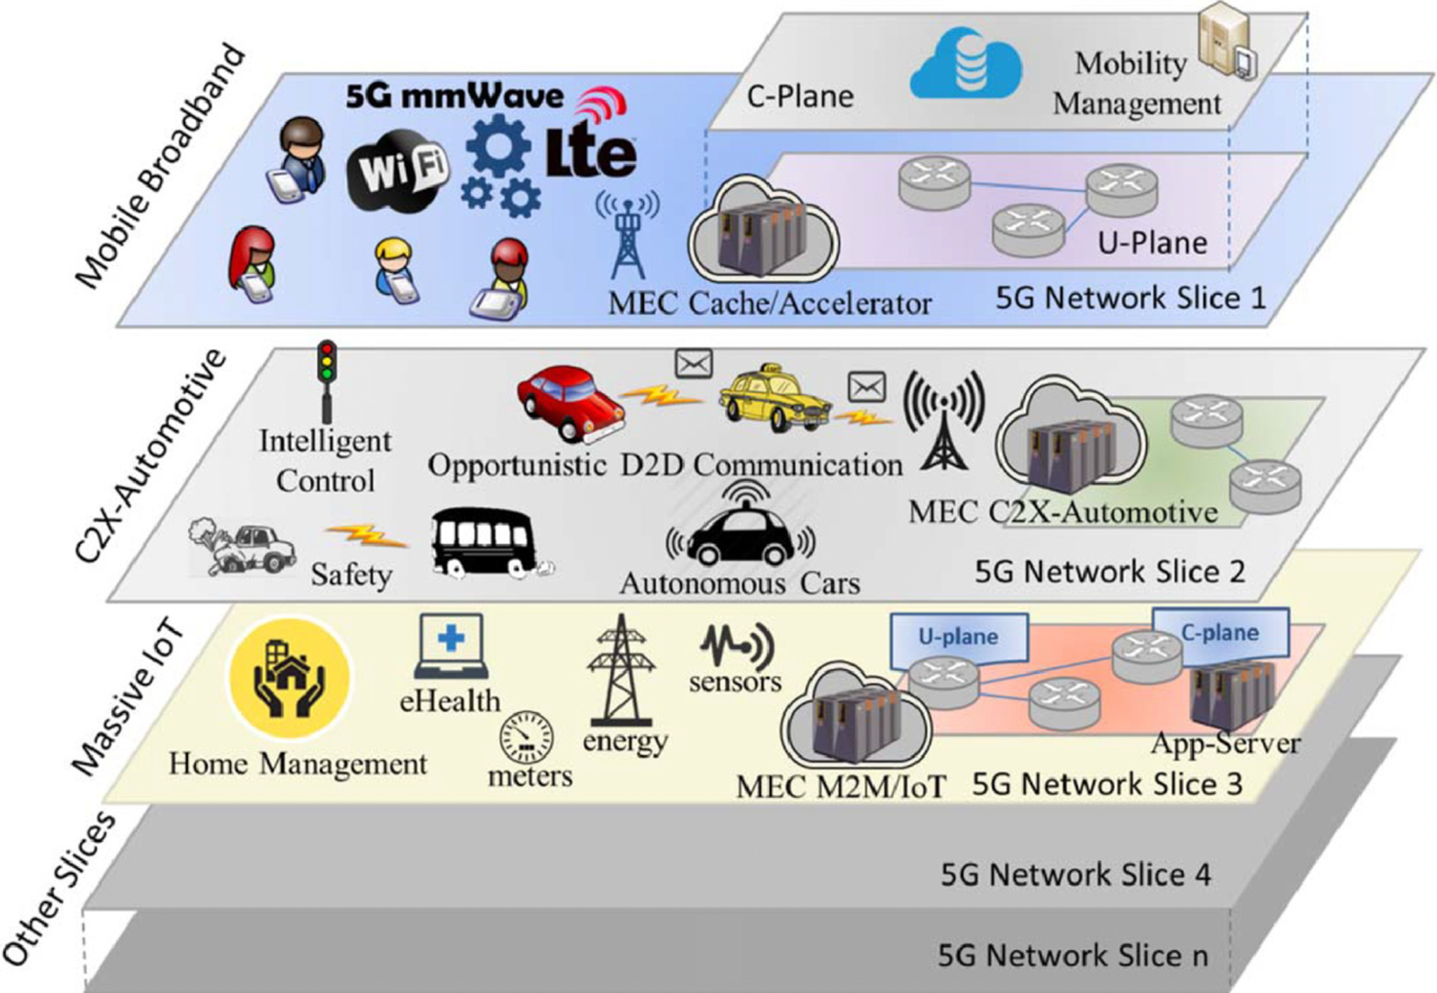
How 5G WORKS…?
Beamforming: Beamforming is another technique used in 5G, where the network focuses the signal directly towards a specific device rather than broadcasting it in all directions. By directing the signal, beamforming improves signal strength, quality, and coverage, leading to better performance and reliability.
Network Slicing: 5G introduces the concept of network slicing, which allows the network to be divided into multiple virtual networks, each tailored to specific requirements. Network slicing enables customized network configurations, ensuring that different applications, industries, or user groups receive the desired level of network performance and resources.

Slide 6

Key Features of 5G Technology
Better connectivity irrespective of the geographic region .
A large number of supporting devices (10 to 100x number of connected devices).
Lower cost of infrastructure development.
Higher reliability of the communications(one millisecond end-to-end round trip delay).

Slide 7
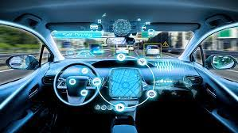
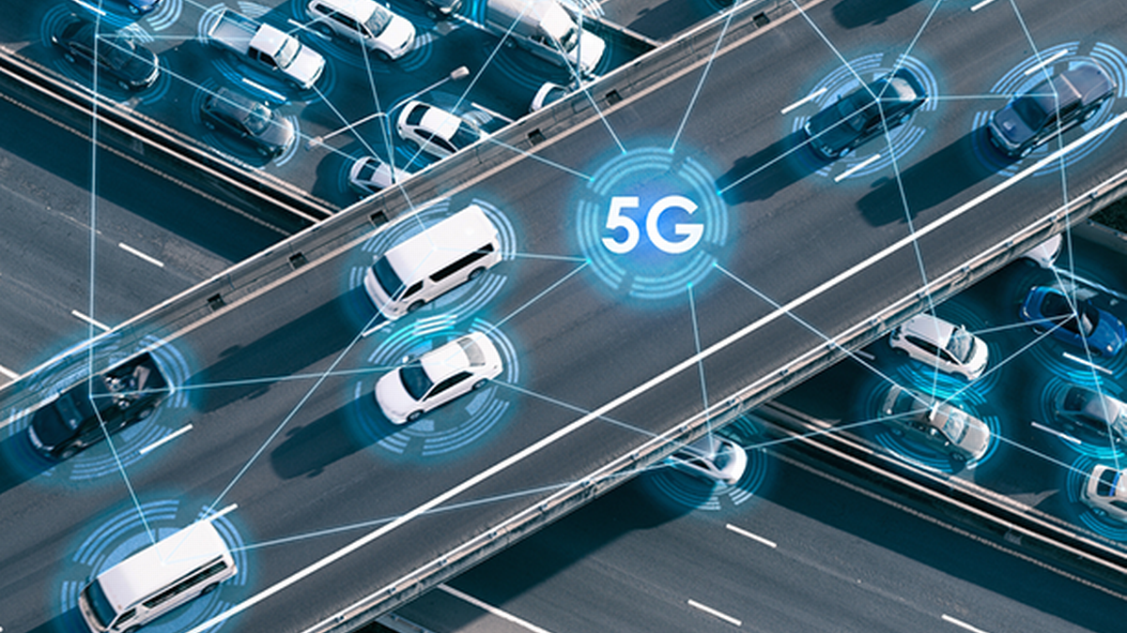
Autonomous vehicle
Applications Of 5G
Autonomous vehicles are being developed empowered with the algorithms and use cases of machine learning, But, 5G and its speed, low latency and further deployment can bring this dream into a reality.
The prime goal behind autonomous vehicle communication is the vehicle-to-everything network. This responsible for the vehicle to act automatically regarding the positioning of objects around the vehicle.

Slide 8
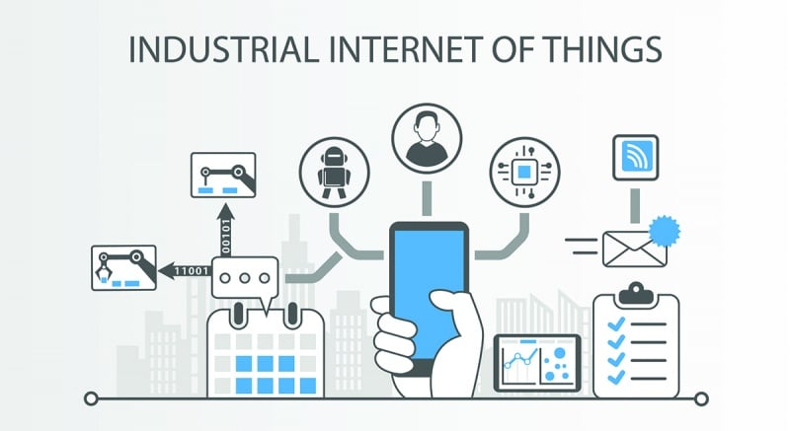
IOT In Industry Use Cases
Applications Of 5G
5G will enable connecting doctors and patients promptly. Additionally, the science of IOT wearables can alert the patient according to the symptoms that the patients are experiencing.
Farming fields should have sensors for monitoring purposes, And, they would convey data regarding the necessity of water, pest management, disease control, etc.

Slide 9
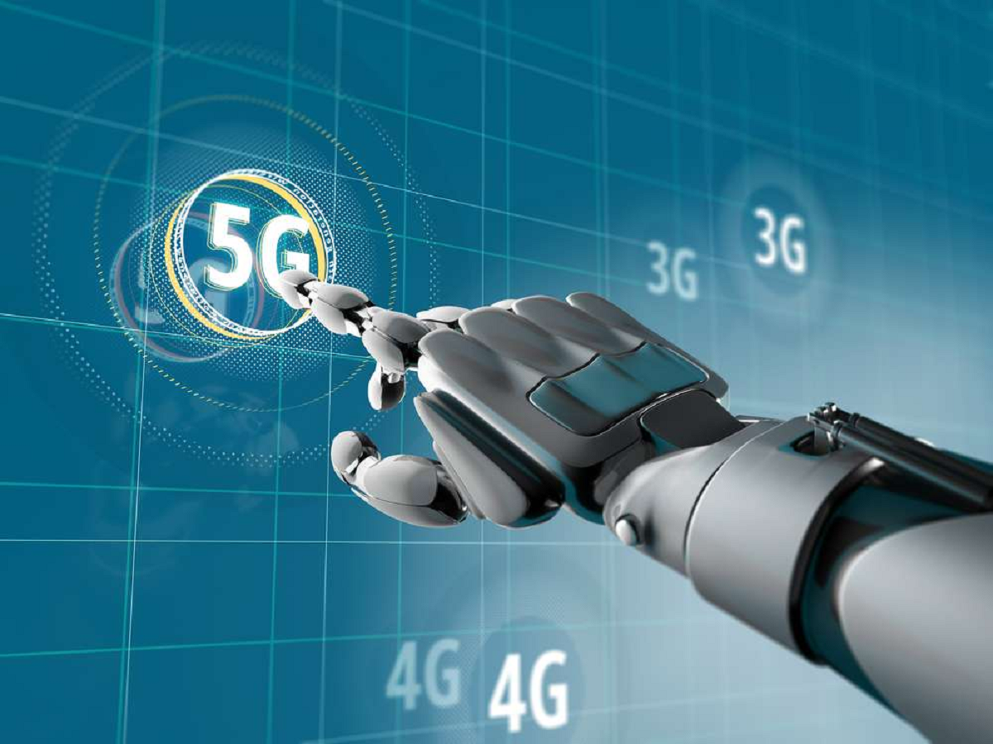
Support to Artificial Intelligence
Applications Of 5G
Artificial intelligence is redefining machine capacities and power. Today’s digital world is meaningless without bulks of data, and it can only be accelerated by the fastest network capabilities and 5G can really trigger the process.
Additionally, smart cities are getting sensors, and data from these smart sensors need to be routed in such a way that they can be deployed at the moment of need.

Slide 10
Conclusion
5G continues to roll out globally, it has the potential to revolutionize sectors like healthcare, manufacturing, transportation, smart cities, entertainment, and more, driving economic growth and enabling a connected world of IoT devices and advanced technologies.

Slide 11
THANK ☺ YOU

